Slide 1
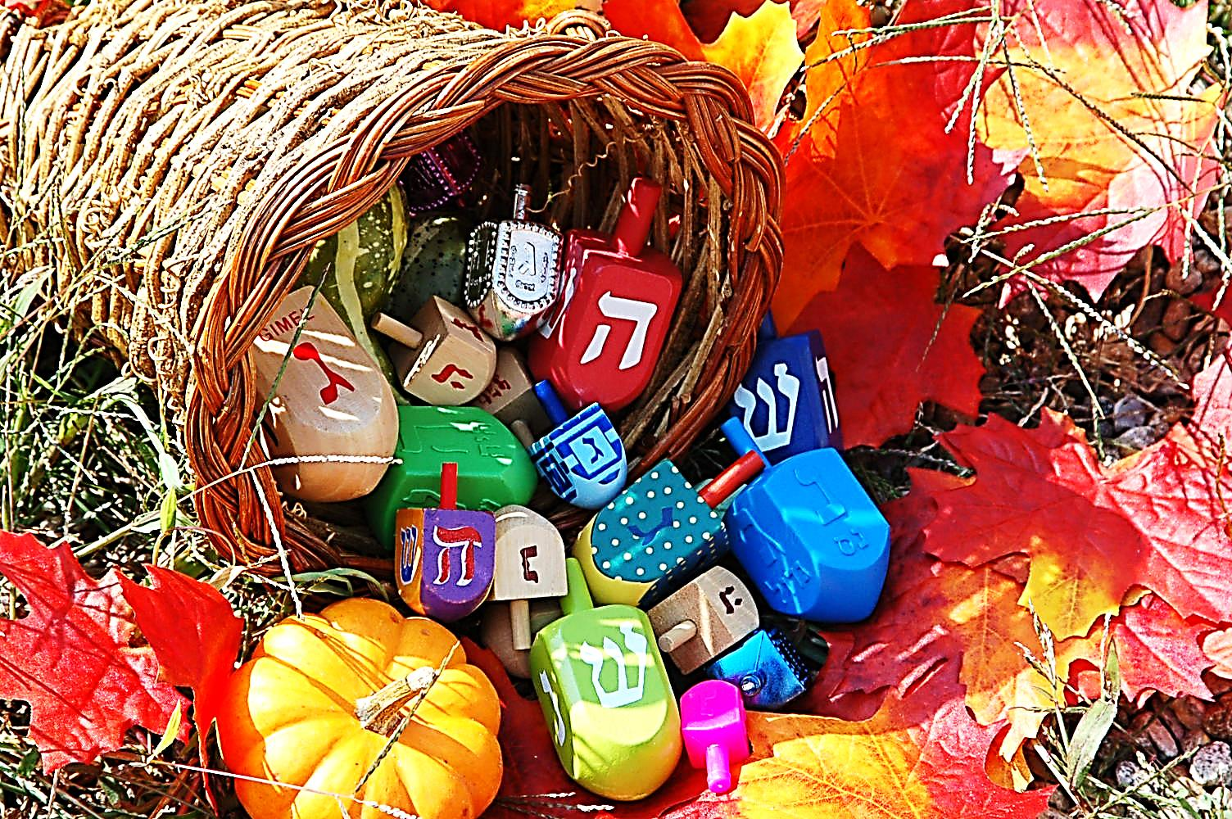
Thanksgiving and Hanukkah God’s Gift of Our Free Will

Slide 2
Note: Any videos in this presentation will only play online. After you download the slideshow, you will need to also download the videos from YouTube & add them back into your PowerPoint.
We present these messages at Bee Creek Park in College Station, TX. If you would like to watch the video of the service with this message, click here:
http://campaignkerusso.org/?p=10866
We would love to know more about the people who download our lessons & sermons. We invite you to email us & let us know where & how you use them.
info@ckbrazos.org

Slide 3
Next Slide - Song: As for Me and My House Download Here: http://youtu.be/t2w_pGMVR-o

Slide 4
Thanksgiving and Hanukkah God’s Gift of Our Free Will

Slide 5
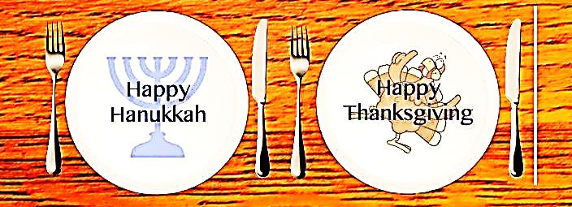
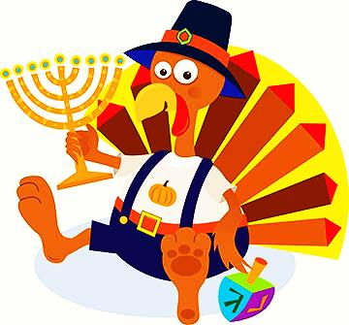
Today we are going to compare the American Thanksgiving holiday with the Jewish holiday called “Hanukkah.”

Slide 6
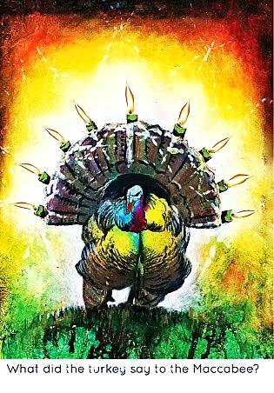
Similar Histories:
True history is a mix of good and bad events.
The Maccabees were oppressed, then free, then oppressed others.
The European Christians were oppressed, then free, then oppressed others.

Slide 7
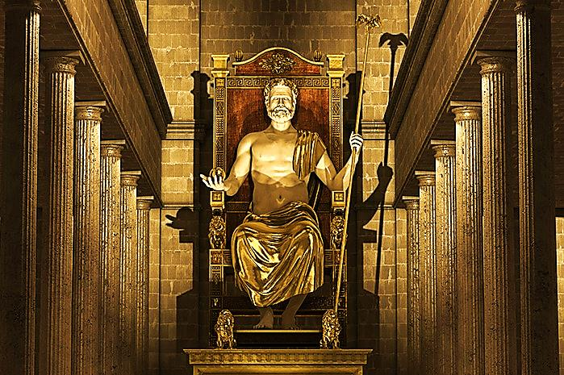
After Alexander the Great’s many conquests, Jewish religious practices. including the reading of the Torah, were forbidden in Jerusalem.
Jews were forced to worship the Greek gods and sacrifice pigs. The idol of the Greek god, Zeus, was placed on the altar in the Temple.

Slide 8
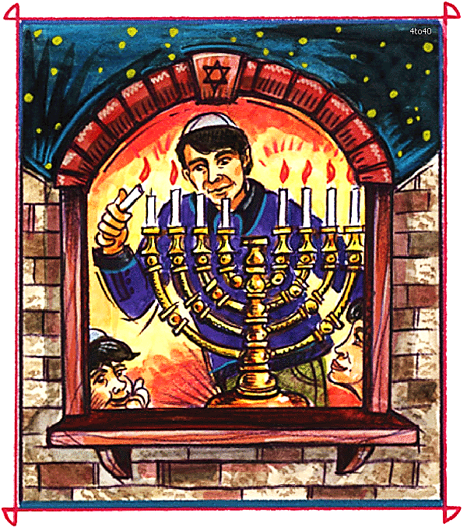
Judas Maccabee led an army of Jewish rebels who took back and ritually cleansed the Temple.
Tradition says they cleansed the temple by lighting the candlestick (or menorah) for eight days, but they had only one jug of oil.
It should have lasted one day, but it burnt for the needed eight days.

Slide 9
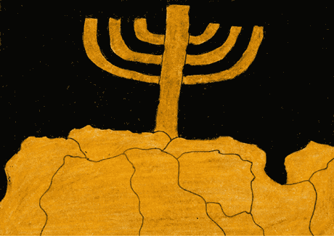
In their zeal, the followers of Maccabees went on to destroy pagan altars in the villages, forcibly remove Gentiles from the land…
…forcibly circumcise boys and force Jewish practices on people.
This group is associated with to the Pharisees of Jesus day

Slide 10
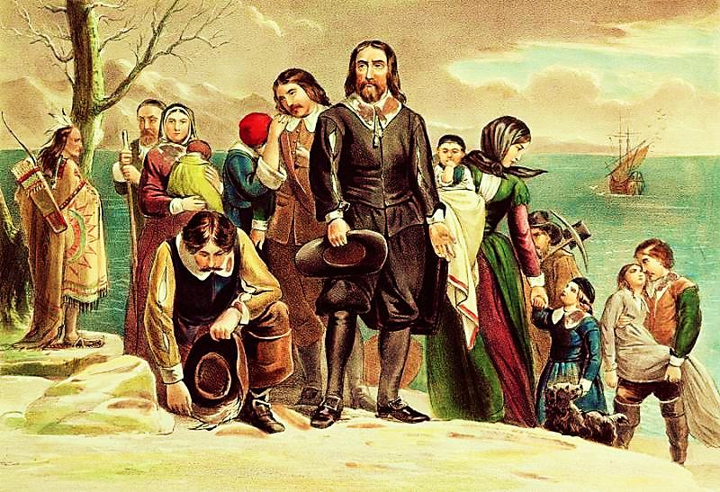
The "Pilgrims," were protestants led by William Bradford who called themselves “Separatists.”
In 1607, the Archbishop of York, raided their homes and imprisoned several members. They boarded the Mayflower and fled to America for freedom of faith.

Slide 11
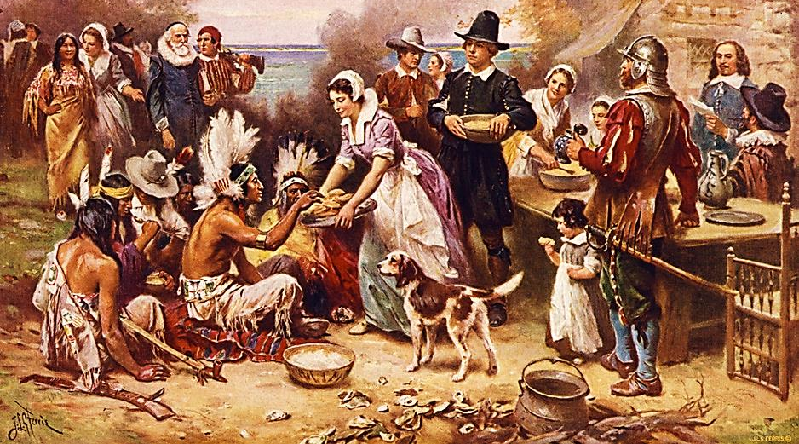
Tradition tells us that “Thanksgiving” commemorates a harvest feast shared between the Pilgrims and the Native Americans.

Slide 12
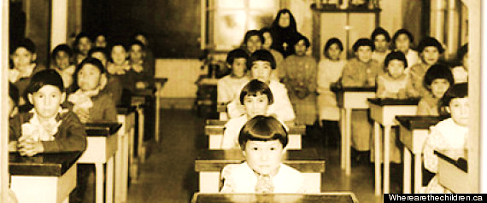
Many years later, 19th to early 20th century, the Bureau of Indian Affairs made a decision to educate native children in separate boarding schools. They were to be assimilated into European culture and faith.

Slide 13
Tiny, child-sized handcuffs from
a Native American museum
They were taken from their families, prohibited from using their native languages and beaten for praying to their native god.

Slide 14
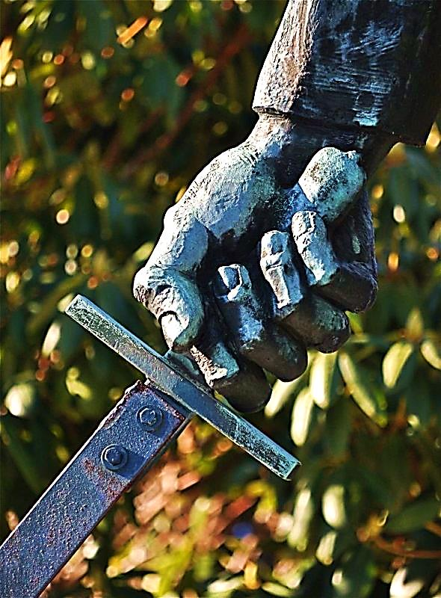
Human zeal and forced conversions (however well intentioned) are not God’s way!!
“Jesus answered, My kingdom is not of this world: if my kingdom were of this world, my servants would surely fight…”
John 18:36

Slide 15
Next Slide - Video: U.S. President Sets Turkey Free Download Here: http://youtu.be/JkLuWu7mFLs

Slide 16
Freedom of Faith is a God-Given Right of All Men

Slide 17
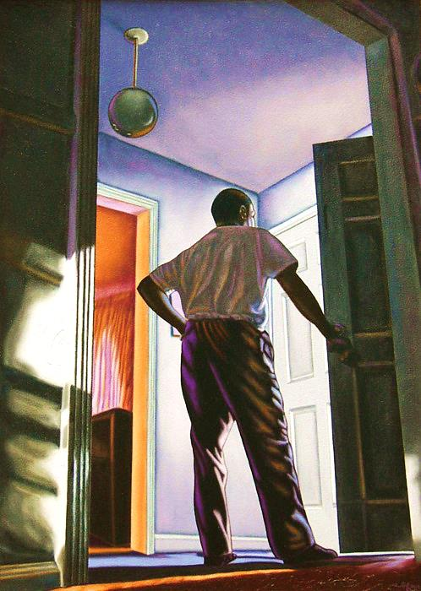
“See! I stand at the door and knock. If anyone hears My voice and opens the door, I will come in to him…”
Revelation 3:20

Slide 18
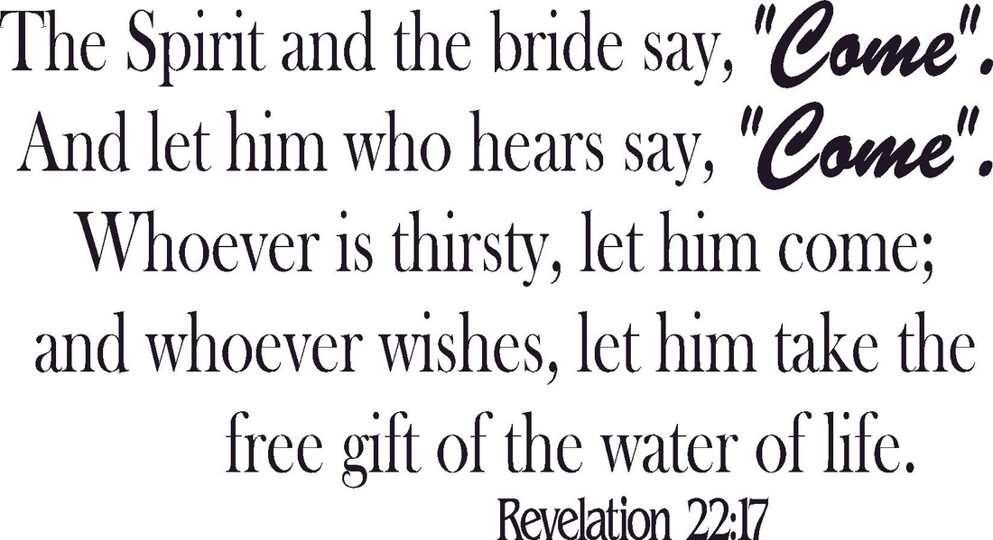

Slide 19
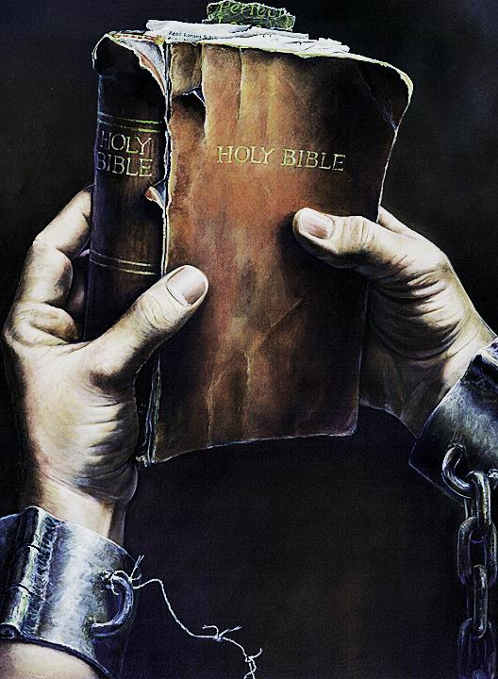
Slaves for Jesus
Jesus has never used His might to enslave people, yet He has had many slaves. These were people who lived to serve Him and often died for Him. They are “LOVE Slaves.”
In the O.T., some slaves refused to be set free even though their time to be freed had come. To show their loyalty, a Love Slave pierced his ear and wore an ear ring.

Slide 20
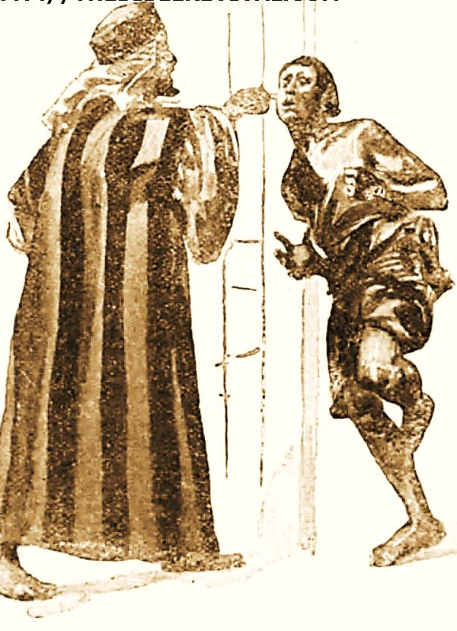
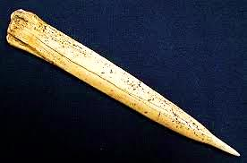
The Only Strong Faith is Free Faith
“But he may say to you, ‘I will not leave you,’ because he loves you and those of your house…
Then take a sharp tool and put it through his ear into the door. And he will be your servant forever.”
Deuteronomy 15:16, 17

Slide 21
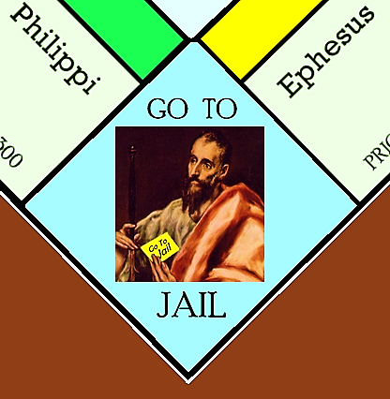
“Sacrifice and offering you did not desire, but my ears you have pierced…” Psalm 40:6
“For Christ’s love compels us…”
2 Corinthians 5:14
“I, Paul, am in prison because I am a missionary for Jesus Christ…” Ephesians 3:1
David & Paul were Christ’s Slaves Motivated by Love Alone

Slide 22
Compelling people to faith in Jesus Christ is the job of the Holy Spirit. He alone can convince people that they have sin in their hearts.
“…He will prove to the people of the world that they are wrong about sin… and about God's judgment.”
John 16:8, 9

Slide 23
“I led them with ropes of human kindness, with ties of love.”
Hosea 11:4

Slide 24
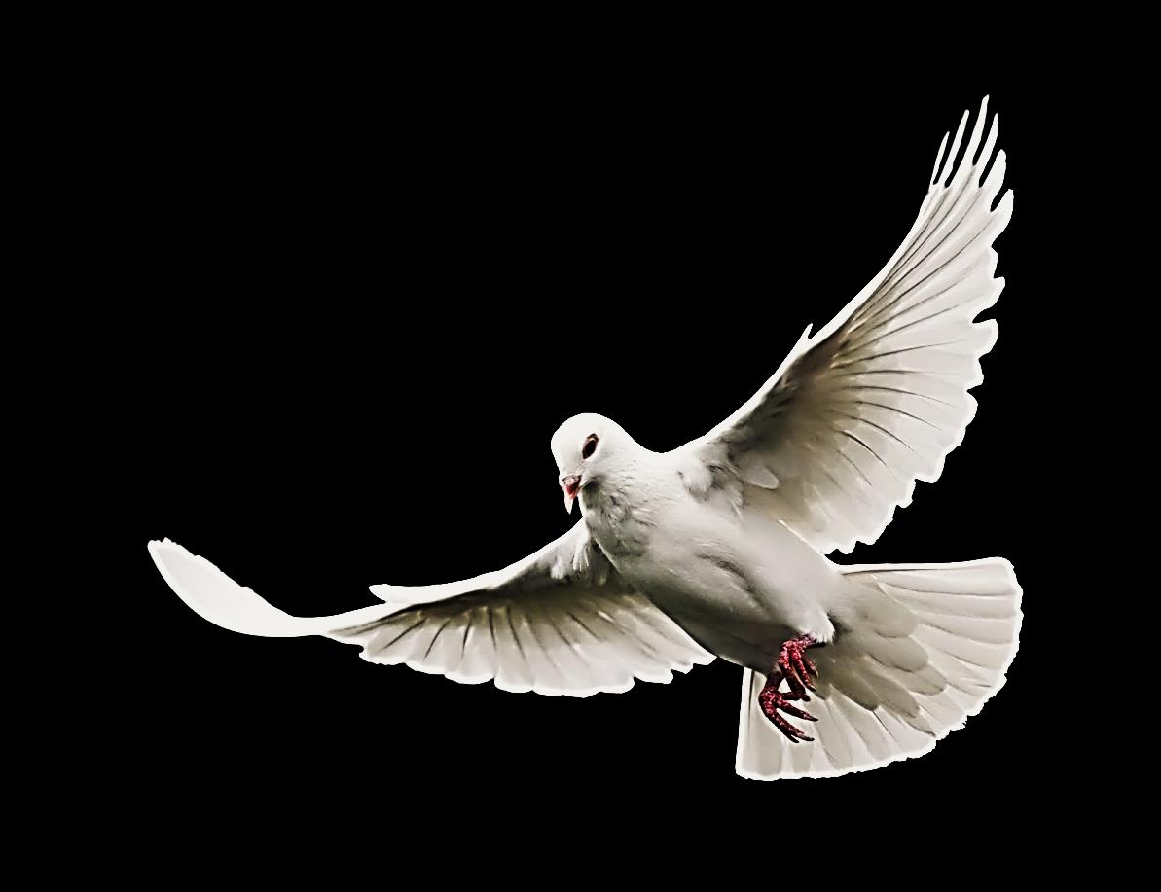
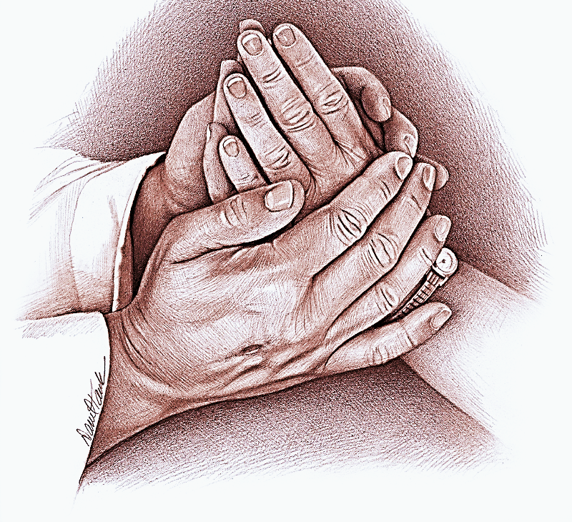
The Holy Spirit Draws People to Jesus
“I have loved you with a love that lasts forever. So I have helped you come to Me with loving-kindness.”
Jeremiah 31:3

Slide 25
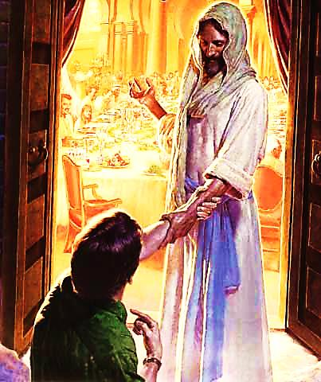
Jesus bought our salvation and set His table of life.
The church sends out the invitations.
The Holy Spirit compels a heart to fall in love with Jesus.

Slide 26
Love Comes from the Heart
Only the Holy Spirit can Cause it
Fall in Love with Jesus

Slide 27
Next Slide→ Song: Power of Your Love Download Here: http://youtu.be/C3QH0B2gjhI

Slide 28
Is Jesus Speaking to You?
“They said to each other, ‘Did not our hearts burn within us while he talked to us on the road, while he opened to us the Scriptures?’”
John Wesley Said:
“…the preacher was describing the change which God works in the heart through faith in Christ and I felt my heart strangely warmed.”
Jesus makes His presence Known by a small voice!

Slide 30
What is the Sinner‘s Prayer?
This is a prayer we can pray when we are ready to admit we are sinners and need Christ’s forgiveness.
It must be prayed with faith in our hearts and a readiness to have a life-changing encounter with Jesus Christ.

Slide 31
A prayer of faith → Pray this prayer if :
If you never have before
You have in the past, but you think it would mean more today
You have been walking afar off and you want to come back
You want to set an example & show others how it is done
You just like to give your heart to Jesus again & again
Faith

Slide 32
We Declare Our Faith Publicly Because Jesus Declared His LOVE Publicly
“If you stand before others and are willing to say you believe in me, then I will tell my Father in heaven that you belong to me.” Mat 10:32

Slide 33
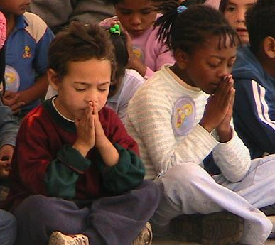
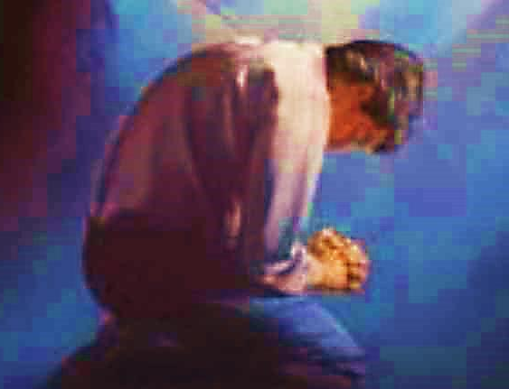
Important Questions
Do you want to know Jesus as your Savior right now?
Do you believe He died to save you from your sins & that He rose from the dead?
Do you believe that He is here, waiting to save you right now?

Slide 34
The Prayer of a Sinner Turning to Jesus
Dear Jesus, I know that I have sinned against You and that my sins separate me from You.
I am truly sorry.
Right now, I turn away from my sinful past .
Please forgive me, and help me to keep from sin.
I believe You died for my sins.
I Believe You rose from the dead, you are alive, and you hear this prayer from my heart.
I invite You Jesus to be both my Savior and the Lord of my life.
I want You to rule my life from now on.

Slide 35
“But some people did accept him. They believed in him, and he gave them the right to become children of God.”
John 1:12

Slide 37
“If you openly say, ‘Jesus is Lord’ and believe in your heart that God raised him from death, you will be saved.”
Rom. 10:9
What did you learn today?
What have you been thinking about God lately?
What do you want to tell others about Jesus?

Slide 38
“Draw near to God, and He will draw near to you…
Altar Time
…Cleanse your hands, you sinners, and make your hearts pure, you who are half-hearted towards God.” James 4:8 WNT

Slide 39
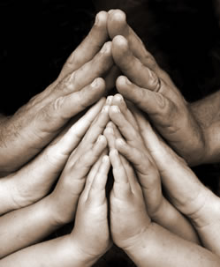
Close in Prayer

Slide 40
Note: Any videos in this presentation will only play online. After you download the slideshow, you will need to also download the videos from YouTube & add them back into your PowerPoint.
We present these messages at Bee Creek Park in College Station, TX. If you would like to watch the video of the service with this message, click here:
http://campaignkerusso.org/?p=11926
We would love to know more about the people who download our lessons & sermons. We invite you to email us & let us know where & how you use them.
info@ckbrazos.org

Slide 41
Welcome to Aggieland Faith Family Style Worship

Slide 42
Would You Like Prayer or Bible Study at Your House?
Personal Prayer: We can come to your home & pray with you, or you can email us when you need prayer.
Home Bible Study: We will come to your home & hold a bible study for you & your friends.
Bible Party: We will hold a Kid’s Bible Party: You provide the food & kids - we will do the bible fun & stories.

Slide 43
Would You Like Visitation?
We will visit a friend, loved one in the hospital or in prison to pray for them & share Christ with them.
Contact: info@aggielandfaith.org

Slide 44
www.aggielandfaith.org
Go here to see pictures & videos
Go here to subscribe to e-mails about changes & cancellations

Slide 45
Note: Any videos in this presentation will only play online. After you download the slideshow, you will need to also download the videos from YouTube & add them back into your PowerPoint.
We present these messages at Bee Creek Park in College Station, TX. If you would like to watch the video of the service with this message, click here:
http://campaignkerusso.org/?p=11926
We would love to know more about the people who download our lessons & sermons. We invite you to email us & let us know where & how you use them.
info@ckbrazos.org

